Slide 1

DEPARTMENT OF
CSE (ARTIFICIAL INTELLIGENCE AND MACHINE LEARNING)
ACADEMIC YEAR 2025 - 2026
SEMESTER III
ARTIFICIAL INTELLIGENCE LABORATORY
MINI PROJECT REVIEW
SUDOKU SOLVER USING BACKTRACKING ALGORITHM
REGISTER NUMBER | 2117240030045
NAME | HARSHINI J
YEAR | II
SECTION | A
FACULTY IN-CHARGE | Mrs. M. Divya

Slide 2
PROBLEM STATEMENT
Artificial Intelligence (AI) can be applied to constraint satisfaction problems, where solutions must satisfy specific rules.
In this project, a Sudoku-solving problem is addressed using the Backtracking algorithm, which systematically explores possible number placements and backtracks when a dead-end occurs.
The project demonstrates how AI techniques can be used for decision-making and problem-solving in constrained environments like Sudoku.
The task is to fill empty cells in a partially completed 9×9 Sudoku grid while ensuring that all rows, columns, and 3×3 subgrids contain numbers 1–9 without repetition.
The problem highlights the need for intelligent search strategies that efficiently explore possibilities and guarantee a valid solution for solvable puzzles.
To design and implement an algorithm capable of solving any given Sudoku puzzle using backtracking.
To provide a graphical user interface (GUI) in Python for entering puzzles, visualizing the solution, and interacting with the grid.
To handle invalid or unsolvable puzzles appropriately, alerting the user when no solution exists.

Slide 3
THEORETICAL BACKGROUND
  Sudoku solving is a constraint satisfaction problem where each cell in the 9×9 grid is treated as a state.
  Backtracking Algorithm is commonly used for solving Sudoku..
  It fills an empty cell with numbers 1–9 and checks row, column, and 3×3 subgrid constraints.
  The algorithm recursively explores the next empty cell and backtracks if a contradiction occurs.
  The advantages are Simple, efficient, and guarantees a solution for valid 9×9 grids.
  Alternative approaches are Constraint Propagation and Stochastic Search (Simulated Annealing).
  Justification: Backtracking is chosen because it is simple, efficient, deterministic, and guarantees a solution for standard 9×9 Sudoku grids, making it ideal for small to medium-sized puzzles.

Slide 4
THEORETICAL BACKGROUND
ALGORITHM
Initialize a 9×9 Sudoku grid with given numbers, using 0 to represent empty cells.
Display the grid using Tkinter entry boxes, where pre-filled numbers are uneditable.
Scan the grid to find the first empty cell (a cell containing 0).
For that empty cell, try placing numbers 1 to 9 sequentially.
For each number, check validity using Sudoku rules — the number must not repeat in the same row, column, or 3×3 subgrid.
If the number is valid, place it temporarily in the current cell and recursively solve the remaining grid.
If a dead end is reached (no valid number fits), backtrack by resetting the cell to 0 and trying the next number.
Continue recursively until all cells are filled correctly, meaning the Sudoku is solved.
When the user clicks “Solve Sudoku”, read all values from the grid into a 2D list and tries to solve it using backtracking algorithm.
Once solved, update the GUI to display the completed grid and show a message saying “Sudoku Solved Successfully!”; otherwise, display “No Solution Exists.”

Slide 5
IMPLEMENTATION AND CODE
Link to code in Git-hub Repository
report
Git Hub Link of the project and report
https://github.com/HarshiniJayakumar/HARSHINI-J

Slide 6
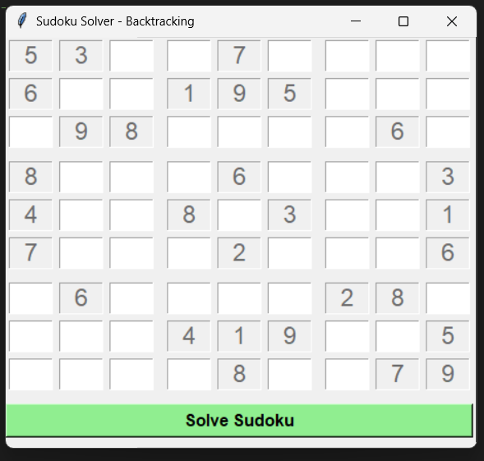
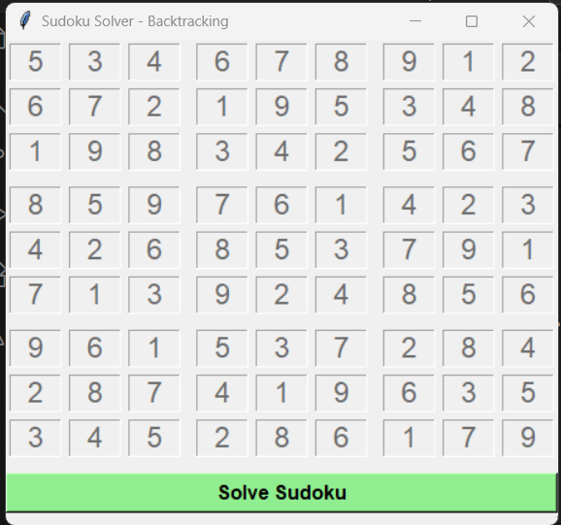
OUTPUT AND RESULTS
The program opens a 9×9 Sudoku grid with pre-filled numbers from the puzzle. Pre-filled numbers are displayed which are uneditable..
Clicking the “Solve Sudoku” button runs the backtracking algorithm to fill in empty cells.
Solved numbers are displayed in the grid (currently in black, editable) while pre-filled numbers remain locked.

Slide 7
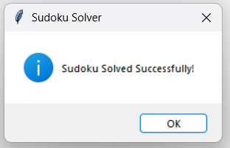
OUTPUT AND RESULTS
If the puzzle is successfully solved, a message box appears:
“Sudoku Solved Successfully!”
If the puzzle is unsolvable, a message box appears:
“No solution exists!”
The final grid clearly shows a complete and valid Sudoku solution, satisfying all row, column, and 3×3 subgrid constraints

Slide 8
OUTPUT AND RESULTS
Results
  The program successfully displays a 9×9 Sudoku grid with pre-filled and empty cells.
  Pre-filled numbers are uneditable.
  Users can enter numbers in empty cells to create custom puzzles.
  Clicking “Solve Sudoku” automatically solves the puzzle using backtracking.
  The algorithm fills all empty cells correctly, adhering to row, column, and 3×3 subgrid constraints.
  A message box confirms when the puzzle is successfully solved.
  If the puzzle is unsolvable, the program alerts the user with a “No solution exists” message.
  The program demonstrates the efficiency and reliability of backtracking for standard 9×9 Sudoku puzzles.

Slide 9
OUTPUT AND RESULTS
Future enhancements
    Add a hint feature to suggest possible numbers for empty cells.
    Implement auto-checking for incorrect user inputs in real-time.
    Include different difficulty levels (easy, medium, hard) by generating puzzles programmatically.
    Add timer and scoring system for competitive Sudoku solving.
    Incorporate color-coded highlights for conflicts or repeated numbers.
    Extend the program to handle larger Sudoku grids (e.g., 16×16).
    Integrate a puzzle generator to create random solvable Sudoku puzzles automatically.

Slide 10
REFERENCES
[1] S. Russell and P. Norvig, Artificial Intelligence: A Modern Approach. Pearson.
[2] “Sudoku Solver using Backtracking in Python,” GeeksforGeeks. [Online]. Available: https://www.geeksforgeeks.org/sudoku-backtracking-7/
[3] “Python Sudoku Solver,” Real Python. [Online]. Available: https://realpython.com/python-sudoku-solver/
[4] Python Official Documentation, Tkinter Library. [Online]. Available: https://docs.python.org/3/library/tkinter.html
[5] “Solving Sudoku with Backtracking,” Towards Data Science. [Online]. Available: https://towardsdatascience.com/solving-sudoku-with-backtracking-196e2f0c31d6

